Slide 1
EZViz
Parallel Bargram Visualization
By Team D Michael DiCicco Abdullah Al Faysal Daniel Eddings (remote)
Notes:
Daniel will be available remotely through Blackboard during the presentation for any questions, etc. as per the project requirements.

Slide 2
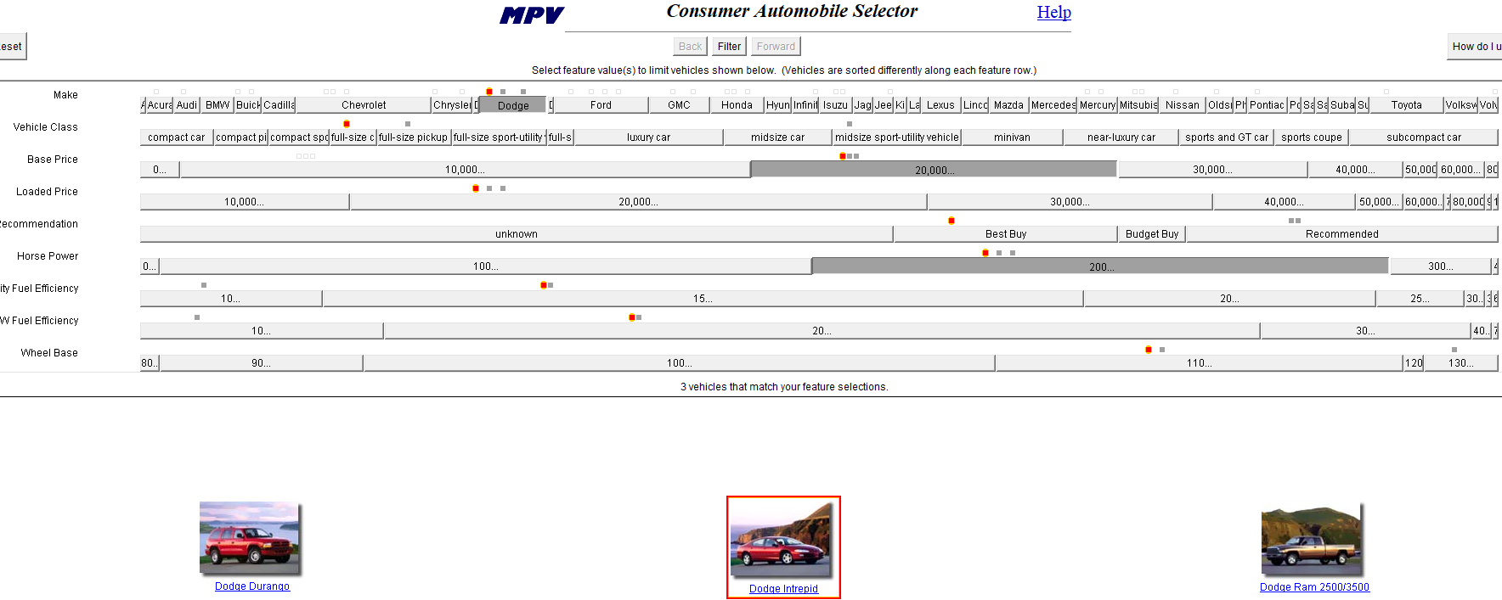
EZChooser “Copyright © 2000 Verizon Laboratories Inc. All rights reserved.”
Notes:
EZChooser was a product of Verizon Labs. Not open source: “All rights reserved.”

Slide 3
Why Parallel Bargrams?
Simple, easy to use
Lots of data has attributes
Used by 100,000 users in the commercial product InfoZoom

Slide 4
Cognitive Economy
Cognitive economy seeks to reduce both the amount of "extraneous" information that the user must manipulate and store in the working memory, and the number and complexity of tasks related solely to the animation.
ME Tudoreanu. Economy of Interaction in Program Visualization: Designing Effective Visualization Tools for Reducing User's Cognitive Effort
Notes:
Direct quote from Dr. Edi’s PhD thesis.

Slide 5
EZChooser
Easy to compare objects directly (at least 3 or 4)
Data-ink ratio is high/good: actual data points above equal-height histograms
Features Bertin’s visual variables (position, size, shape, etc)
Limited to < 2,000 items in data set (1080p resolution is 1,920 pixels)
Notes:
As per the EZChooser paper, 1 pixel can represent 1 data point. Need additional pixels for labels and gaps.
May have a separate slide to show visual variables in EZViz Potential issues/solutions concerning data-ink ratio (like too much vertical space): https://www.edwardtufte.com/bboard/q-and-a-fetch-msg?msg_id=000076
https://www.onepager.com/community/blog/renowned-graphics-expert-tufte-still-thinks-our-project-charts-are-mediocre/

Slide 6
EZChooser
Works Great
Not Widely Available
$$$
Simple, intuitive interface
See-as-you-go visualization
Released in 2000
Needs an old browser like Opera 8 installed along with JDK 2
Java applet with outdated look
A similar commercial product, InfoZoom, is expensive

Slide 7
EZViz
Runs Anywhere
Open Source
Solid Foundation
Browser-based like EZChooser (sans applets)
Github project
ECMAScript 6
Papa Parse JS
Notes:
EZChooser required its own format that was a CSV file with rules at the top of each file.

Slide 8
Sample Data
Academic Data: Articles, authors, conferences
Data from original EZChooser
Flights from Little Rock airport
Notes:
May have a separate slide to show visual variables in EZViz Potential issues/solutions concerning data-ink ratio (like too much vertical space): https://www.edwardtufte.com/bboard/q-and-a-fetch-msg?msg_id=000076
https://www.onepager.com/community/blog/renowned-graphics-expert-tufte-still-thinks-our-project-charts-are-mediocre/

Slide 9
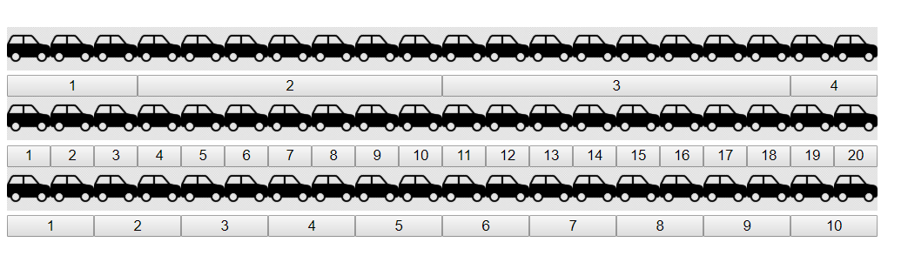
Proof of Concept
Notes:
Future comparison slide to show screenshot of EZChooser on left and EZViz on right.

